Slide 1


Employee data analysis using pivot table
Priyadharshini .S
312206528
COMMERCE
AM JAIN COLLEGE

Slide 2
PROJECT TITLE
EMPLOYEE DATA ANALYSIS USING PIVOT TABLE

Slide 3
AGENDA
PROBLEM
PROJECT OVERVIEW
USERS
DATASET DESCRIPTION
MODELLING APPROACH
RESULTS
CONCLUSION
.

Slide 4
PROBLEM STATEMENT
This analysis is to give brief summary of employee’s background for understanding employees to implement conveyances and transport schemes
This helps the employees to reduce their conveyance cost and work with less pressure of transport availability and traffics

Slide 5
Project overview
This is quick summary of employee date of joining , branch , education and gender for better analysis

Slide 6
End users
Managers
Employers
Organisation
Industrialist
Employees
Public

Slide 7
Our solution
Summary of employee data using pivot table (excel)

Slide 8
Dataset description
Employee dataset downloaded from Kaggle.com
9 features
education
joining year
city
age
gender,
Experience ,etc

Slide 9
Modelling
Dataset collected from www.Kaggle.com
Entire data is selected and insert pivot table field and drag the branch to column box and joining to row box
Pivot table will be created
Then select the table and choose a suitable chart from main ribbon
You can further differentiate the chart with the help of slicers
Add slicer if neccesary

Slide 10
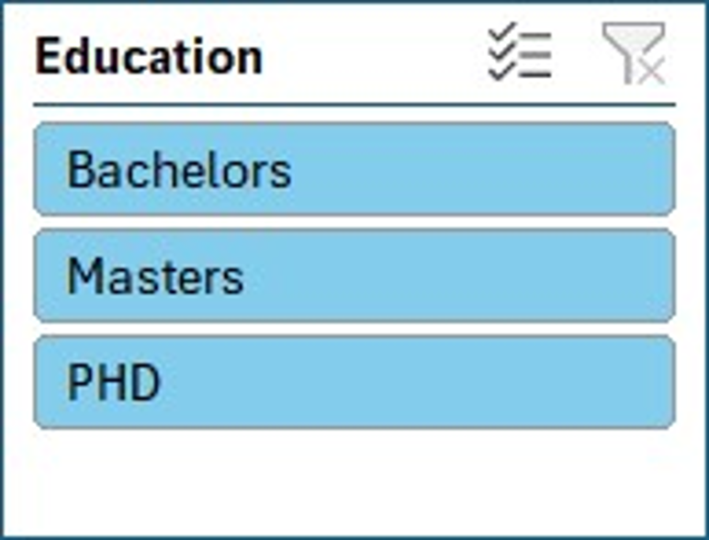
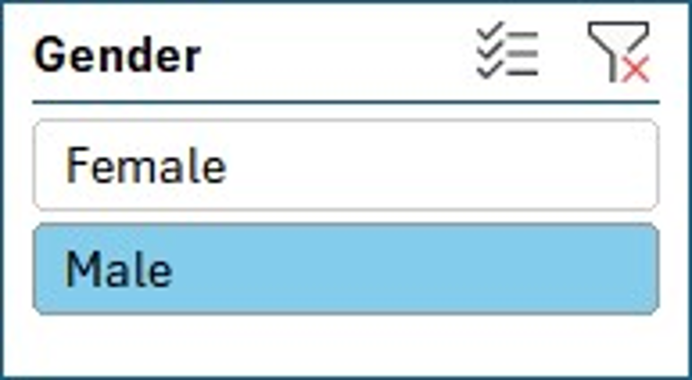
RESULT

Slide 11
conclusion
This provide a overall view of experience and branch they work at gender wise and education wise
Thus, it helps in formulating conveyance scheme and motivate them to come to work hassle free

